Slide 1
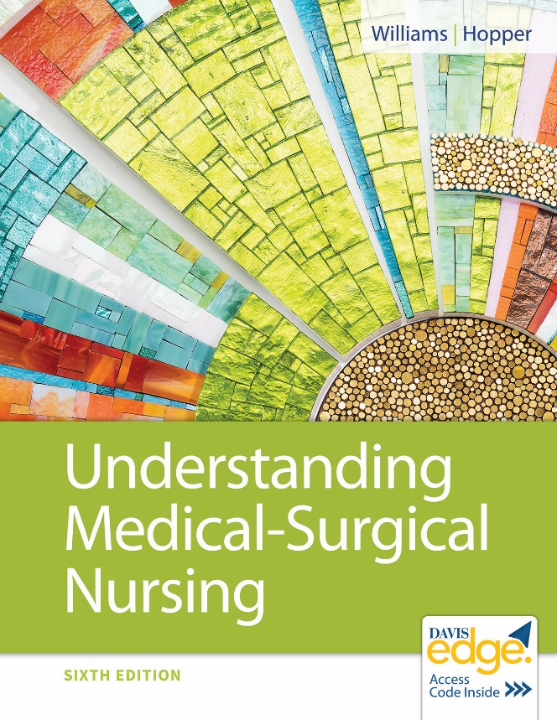
Chapter 46
Nursing Care of Patients With Musculoskeletal and Connective Tissue Disorders

Slide 2
Learning Outcomes
Explain the pathophysiology, signs and symptoms, and complications of fractures.
Plan nursing care for a patient in a splint, cast, traction, or external fixation.
Describe the causes and prevention of osteomyelitis.
Plan nursing care for osteomyelitis.

Slide 3
Learning Outcomes (continued_1)
Describe risk factors, pathophysiology, treatment, and nursing care for osteoporosis.
Describe the pathophysiology, treatment, and nursing care for gout.
Compare the care for osteoarthritis and rheumatoid arthritis.

Slide 4
Learning Outcomes (continued_2)
Plan nursing care for the patient with a fractured hip.
Plan nursing care for a patient having a total joint replacement.
Explain patient teaching for a patient with a lower extremity amputation and prosthesis.

Slide 5
Bone and Soft Tissue Disorders
Strain
Sprain
Dislocation
Bursitis
Rotator cuff injury

Slide 6
“R I C E”
Rest to protect it
Ice to decrease pain, swelling, inflammation
Compression with elastic bandage
Elevating affected area (if appropriate)

Slide 7
Be Safe!
Use lifting devices.
Draw sheets
Mechanical moving devices
Avoid pulling up on patient’s arms to avoid patient injury.

Slide 8
Carpal Tunnel Syndrome
Median nerve compression in wrist’s carpal tunnel
Occurs with swelling in tunnel
Finger, hand, arm pain/numbness
Relieve inflammation and rest wrist.
Splint
Anti-inflammatory
Surgery
Teach prevention.

Slide 9
Fractures
Break in a bone
Cause
Trauma
Pathological (from disease)
Open: Breaks skin
Closed: Does not break skin
Infection risk

Slide 10
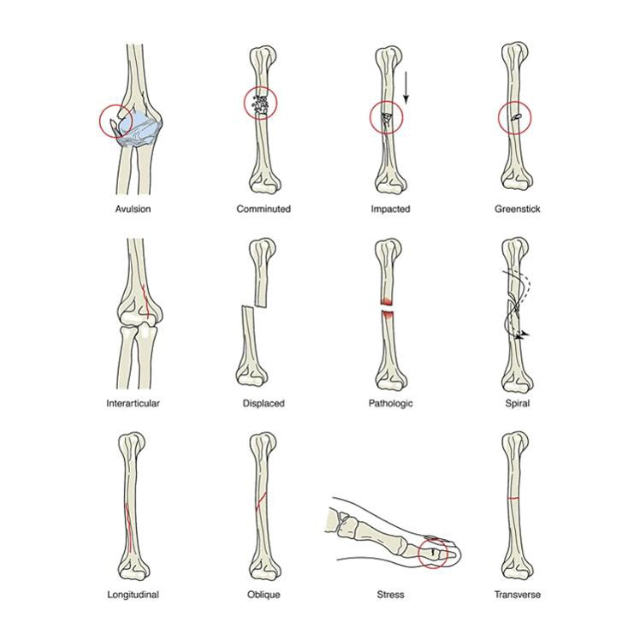
Types of Fractures

Slide 11
Fractures (continued_1)
Signs and symptoms
Pain
Decreased range of motion
Limb rotation
Deformity, shortening of limb
Swelling
Bruising

Slide 12
Fractures (continued_2)
Diagnostic tests
X-ray
Computed tomography (C T) scan
Emergency treatment
Splint it as it lies!
Seek medical treatment.
Therapeutic goals
Realignment of bone ends
Immobilization

Slide 13
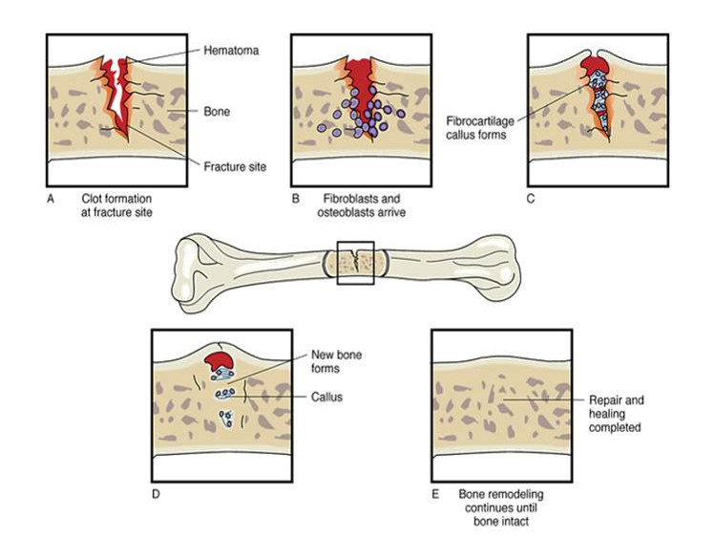
Fracture Healing Phases

Slide 14
Fractures (continued_3)
Management
Closed reduction
Manual realignment
Elastic wrap/splints
Casts
Traction
Skin
Skeletal

Slide 15
Fractures (continued_4)
Management (continued)
Open reduction with internal fixation
Metal plates, screws
Prosthesis
External fixation
Pins, metal frame
Allows care of wounds

Slide 16
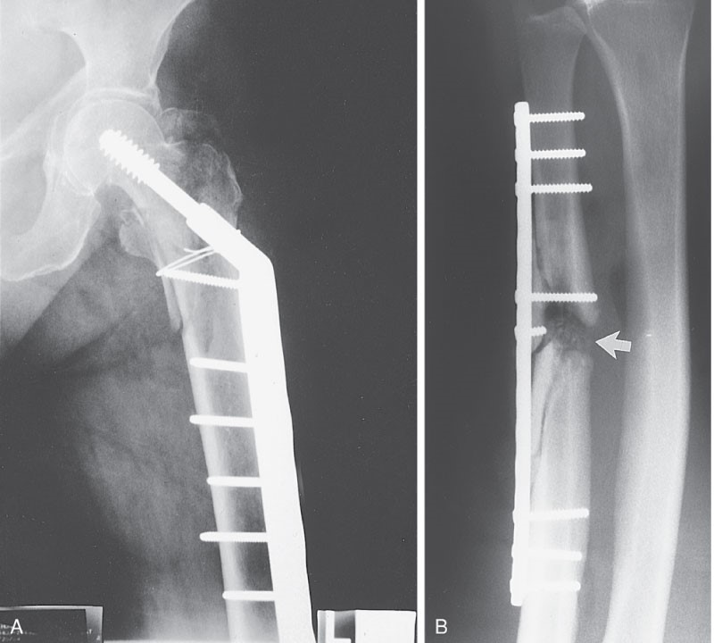
Internal Fixation
A. Intertrochanteric fracture of the hip with fracture fixation via a side plate and screw combination device
B. Side plate and screw fixation of radial fracture

Slide 17
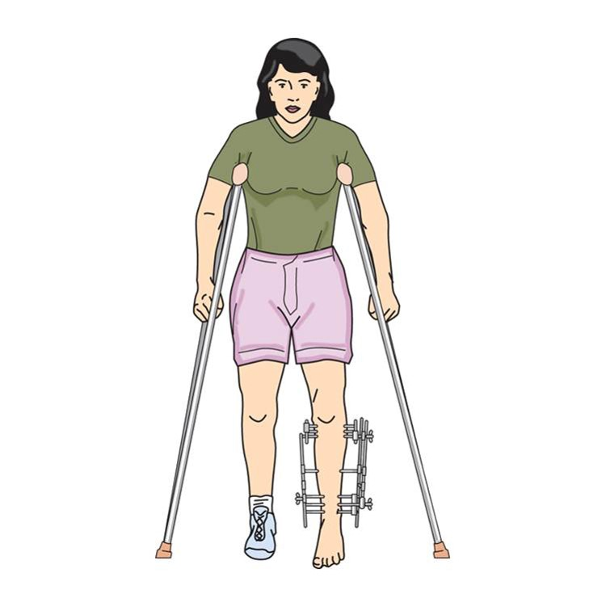
External Fixation

Slide 18
Fractures (continued_5)
Complications
Nonunion
Neurovascular compromise
Hemorrhage
Infection
Thromboembolic complications
Acute compartment syndrome
Fat embolism syndrome

Slide 19
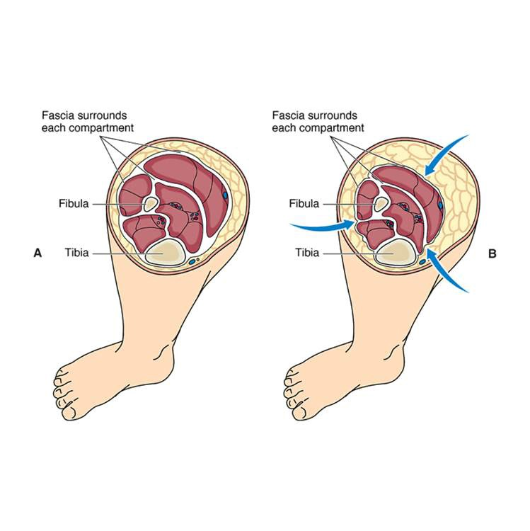
Compartment Syndrome
A. Lower leg compartments
B. Compartment syndrome

Slide 20
Fractures (continued_6)
Nursing diagnoses
Acute Pain
Impaired Physical Mobility
Risk for Peripheral Neurovascular Dysfunction

Slide 21
Fractures (continued_7)
Nursing care
Cast, traction, pin care
Palming wet cast
Pain management
Neurovascular checks
Skin care
Nutrition
Self-care deficits
Psychosocial

Slide 22
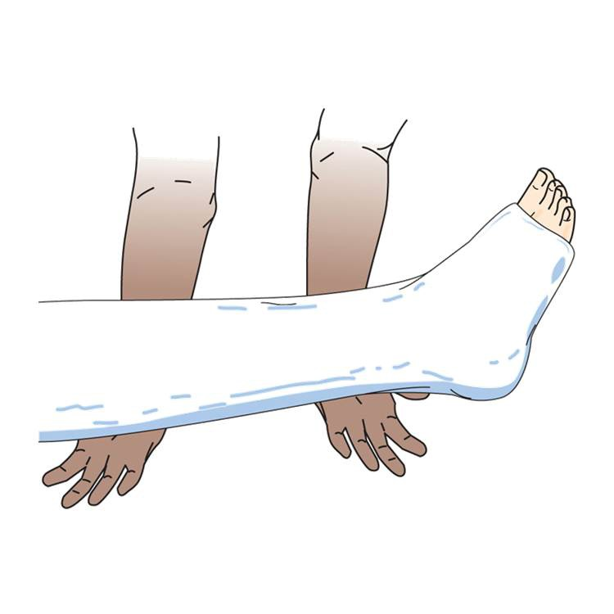
Palming the Cast

Slide 23
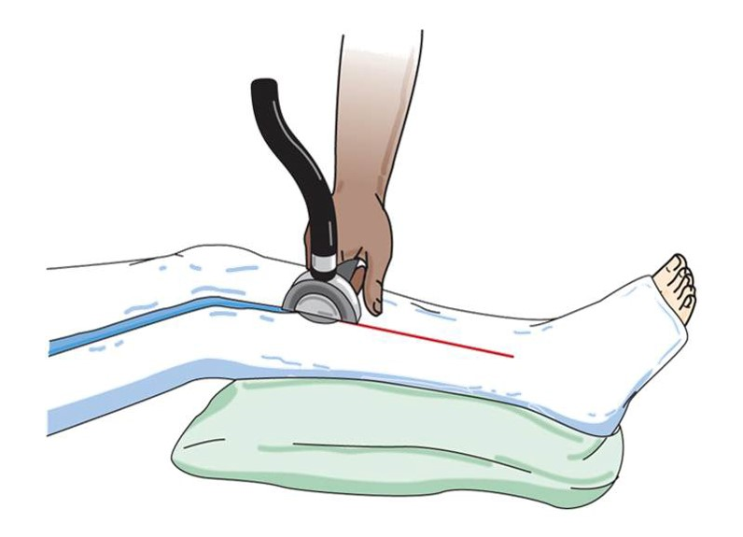
Bivalving Cast

Slide 24
Fractures (continued_8)
Patient education
Cast care
Pin care
Nutrition

Slide 25
Osteomyelitis
Infection of bone
Site pain, redness, warmth, swelling, fever
Curative therapy
Debridement, reconstruction, antibiotic
Palliative therapy
Chronic suppressive antibiotic therapy
Nonresponsive
Amputation

Slide 26
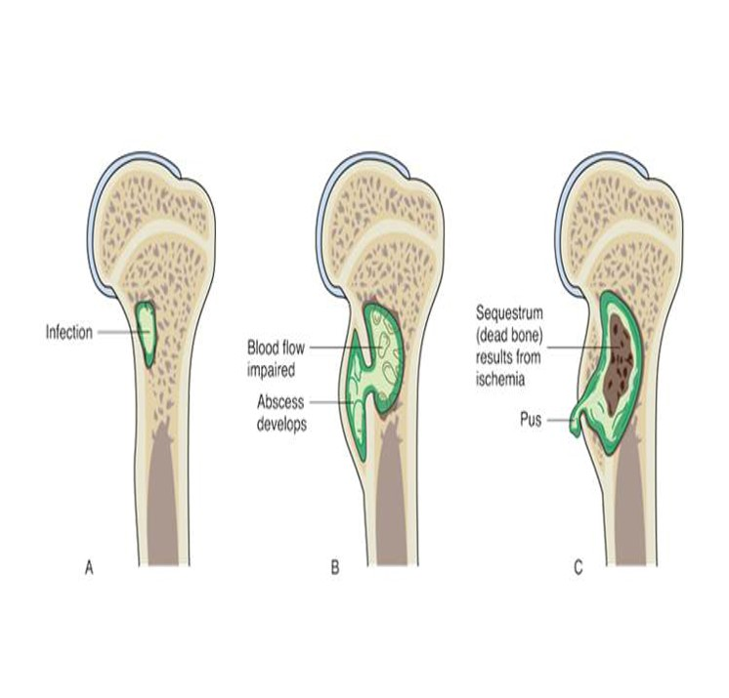
Osteomyelitis (continued_1)

Slide 27
Osteomyelitis (continued_2)
Nursing care
Prevention is key!
Hand hygiene
Sterile dressing changes
Medication teaching

Slide 28
Osteoporosis
Metabolic disorder of low bone mass
Prone to fractures
Most common: Spine, wrist, hip
All bones affected
Imbalanced remodeling process

Slide 29
Osteoporosis (continued_1)
Prevalence
54 million people
Women at greatest risk
Healthy People 2020 objective: Reduce proportion of adults over age 50 with osteoporosis from 5.9% to 5.3%.

Slide 30
Osteoporosis (continued_2)
Hip/vertebral fractures
Reduced quality of life
Increased disability
Risk of death (during year after fracture)

Slide 31
Osteoporosis (continued_3)
Nonmodifiable risk factors
Female gender
Aging
Caucasian or Asian
Small boned, petite body build
Postmenopausal status
Low testosterone and estrogen in men
Family history of osteoporosis or fractures
History of fractures

Slide 32
Osteoporosis (continued_4)
Modifiable risk factors
Low calcium and vitamin D intake
Excessive caffeine, protein, sodium
Sedentary lifestyle
Excessive alcohol use
Cigarette smoking

Slide 33
Osteoporosis (continued_5)
Prevention
Build bone through age 30.
Obtain adequate calcium and vitamin D.
Do weight-bearing exercise (especially childhood).
Avoid alcohol and smoking.

Slide 34
Osteoporosis (continued_6)
Signs and symptoms
Back pain
Height decreases
Fracture
Kyphosis

Slide 35
Osteoporosis (continued_7)
Effects
Deformities
Functional effects
Emotional effects
Socialize less

Slide 36
Osteoporosis (continued_8)
Diagnostic tests
Dual-energy x-ray absorptiometry (D E X A)
Serum calcium, vitamin D decreased
Serum phosphorus increased
Serum alkaline phosphatase increased

Slide 37
Osteoporosis (continued_9)
Therapeutic interventions
Reduce risk factors
Calcium supplements
Vitamin D supplements
Medications

Slide 38
Osteoporosis (continued_10)
Therapeutic interventions (continued)
Antiresorptive medications
Bisphosphonates
Alendronate (Fosamax)
Ibandronate (Boniva)
Risedronate (Actonel)
Zoledronic Acid (Reclast)
Calcitonin (Fortical, Miacalcin)

Slide 39
Osteoporosis (continued_11)
Therapeutic interventions (continued)
Antiresorptive medications (continued)
Monoclonal antibody
Denosumab (Prolia)
Selective estrogen receptor modulator
Raloxifene (Evista)
Estrogen therapy
Anabolic (bone forming)
Teriparatide (Forteo)

Slide 40
Osteoporosis (continued_12)
Nursing care
Pain relief
Symptom management
Education
Prevention
Diet: Increase calcium, vitamin D
Exercise
Medication
Fall prevention

Slide 41
Paget Disease
Rare noncurable metabolic bone disease
Abnormal weak bones
Painful
Diagnostic test: X-ray
Bisphosphonates, calcitonin
Relieve pain, teaching, promote life quality

Slide 42
Bone Cancer
Primary malignant tumors
Osteosarcoma
Most common and fatal
Metastasizes to lung within 2 years
Males mostly
Ewing sarcoma
Most malignant

Slide 43
Bone Cancer (continued)
Signs and symptoms
Site pain and swelling
Tender, palpable mass
Therapeutic interventions
Surgery, chemotherapy, radiation
Nursing care
Postoperative care
Supportive care

Slide 44
Metastatic Bone Disease
Bone-seeking cancers
Prostate, breast, lung, thyroid
Pathological fractures
Severe pain
Therapeutic interventions
Radiation
Nursing care
Supportive care, as with other cancers

Slide 45
Gout
Pathophysiology
Systemic connective tissue disorder
Uric acid build-up
Urate crystals deposited in joints/connective tissues
Severe inflammation

Slide 46
Gout (continued_1)
Causes and types
Primary
Inherited problem with purine metabolism
Secondary
Another health issue
Medications

Slide 47
Gout (continued_2)
Signs and symptoms
Acute
Swollen, red, hot, painful inflamed joints
Great toe
Chronic gout
Urate deposits under skin (tophi)
Renal stones

Slide 48
Gout (continued_3)
Diagnostic tests
Serum uric acid
Joint fluid: Uric acid crystals

Slide 49
Gout (continued_4)
Therapeutic interventions
Medication
Acute
Colchicine (Colcrys)
N S A I D’s
Prevention
Febuxostat (Uloric), Allopurinol (Zyloprim)
Probenecid (Benemid)

Slide 50
Gout (continued_5)
Nursing care
Teaching
Diet: Avoid foods high in purines.
Eat cherries/drink cherry juice.
Avoid aspirin, diuretics, alcohol, stress.
Increase fluids to avoid kidney stones.

Slide 51
Osteoarthritis
Affects more than 30 million people
Common
Degenerative joint disease
Increases with age

Slide 52
Osteoarthritis (continued_1)
Pathophysiology
Affects entire joint
Articular cartilage/joints bone ends deteriorate
Joint space narrows, bone spurs develop, joint inflamed
Joint deformities, pain, immobility
Weight-bearing joints

Slide 53
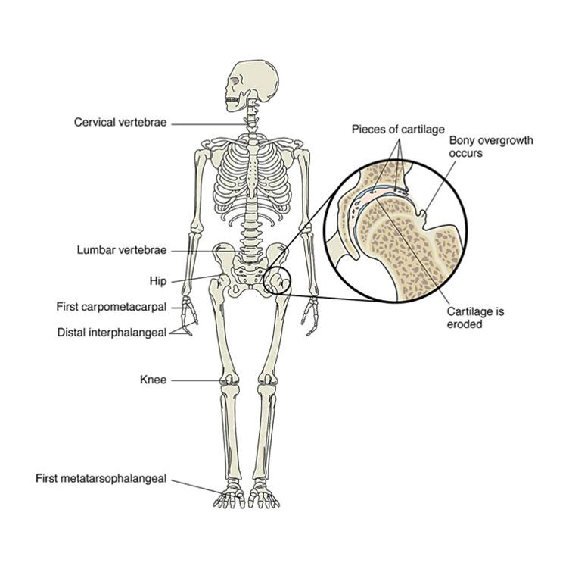
Joints Affected by Osteoarthritis

Slide 54
Osteoarthritis (continued_2)
Risk factors
Heredity
Aging
Obesity
Excessive “wear and tear” on synovial joints

Slide 55
Osteoarthritis (continued_3)
Signs and symptoms
Joint pain
Intensifies after physical activity
Stiffness
Heberden and Bouchard nodes
Bony nodes on joints of fingers

Slide 56
Osteoarthritis (continued_4)
Diagnostic tests
X-Rays
Magnetic resonance imaging (M R I)
Synovial fluid analysis

Slide 57
Osteoarthritis (continued_5)
Therapeutic interventions
No cure
Exercise
Weight control
Medication
N S A I D’s
Synvisc-One
Heat or cold therapy
Complementary therapies
Imagery, music therapy, acupressure, acupuncture
Surgery
Total joint replacement

Slide 58
Osteoarthritis (continued_6)
Nursing diagnoses
Acute Pain
Activity Intolerance
Chronic Sorrow
Disturbed Body Image
Impaired Physical Mobility
Self-Care Deficit (Bathing, Dressing, Feeding, Toileting)

Slide 59
Osteoarthritis (continued_7)
Patient education
Protect joints.
Conserve energy.

Slide 60
Rheumatoid Arthritis
Chronic, progressive, systemic inflammatory disease
Destroys synovial joints and other connective tissues
Includes major organs

Slide 61
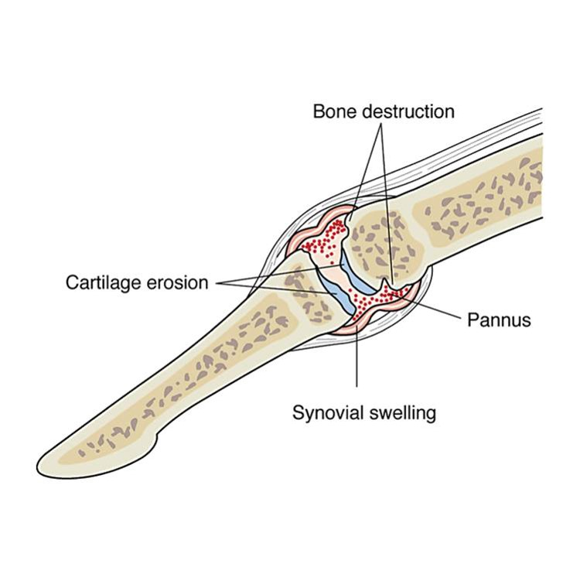
Rheumatoid Arthritis (continued_1)

Slide 62
Rheumatoid Arthritis (continued_2)
Pathophysiology
Synovitis
Synovium thickens, fluid accumulates
Destructive pannus erodes joint cartilage, destroys joint bone
Pannus converted to bony tissue
Joint deformity
Other connective tissue affected

Slide 63
Rheumatoid Arthritis (continued_3)
Etiology
Genetic predisposition
Oral pathogens may cause
Autoimmune response: Antibodies (rheumatoid factor)
Local and systemic inflammation
Signs and symptoms
Remissions and exacerbations
Varies by individual

Slide 64
Rheumatoid Arthritis (continued_4)
Signs and symptoms (continued)
Early symptoms
Bilateral, symmetrical joint inflammation
Reddened, warm, swollen, stiff, painful
Stiffness after resting
Activity decreases pain and stiffness
Low-grade fever, weakness, fatigue, anorexia
Late symptoms
Joint deformity
Secondary osteoporosis

Slide 65
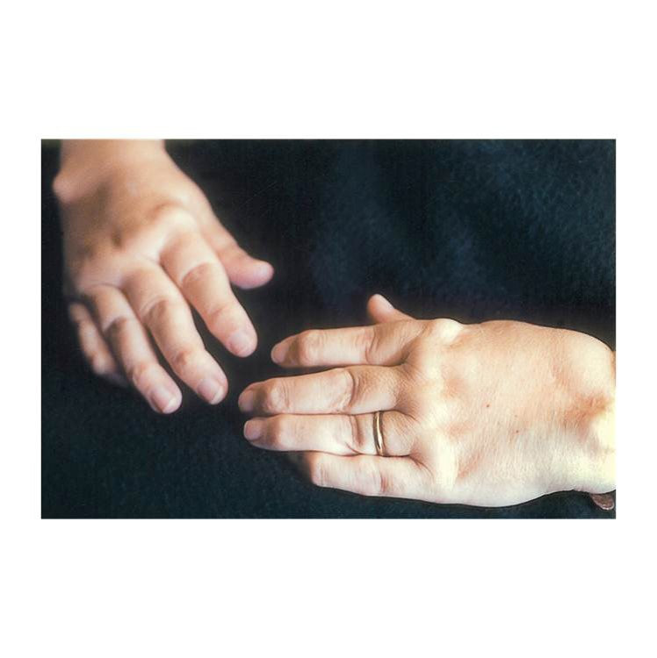
Joint Abnormalities in Rheumatoid Arthritis

Slide 66
Rheumatoid Arthritis (continued_5)
Diagnostic tests
Rheumatoid factor
Red blood cell
C subscript 4 complement decreased
Erythrocyte sedimentation rate
Antinuclear antibody
C-reactive protein

Slide 67
Rheumatoid Arthritis (continued_6)
Therapeutic interventions
Medication
Antibiotics
Disease-modifying antirheumatic drugs
Leflunomide (Arava)
Etanercept (Enbrel)
Methotrexate
Gold
N S A I D’s
Prednisone

Slide 68
Rheumatoid Arthritis (continued_7)
Therapeutic Interventions (continued)
Heat/cold
Balanced rest and activity
Surgery: Total joint replacement

Slide 69
Rheumatoid Arthritis (continued_8)
Nursing diagnoses
Acute Pain
Disturbed Body Image
Fatigue
Self-Care Deficit (Bathing, Dressing, Feeding, Toileting)
Impaired Physical Mobility

Slide 70
Rheumatoid Arthritis (continued_9)
Patient education
Disease process
Medication management
Rest and exercise
Vocational counselor
Community resources

Slide 71
Total Hip Replacement
Acetabular cup inserted into pelvic acetabulum
Femoral component inserted into femur

Slide 72
Total Hip Replacement (continued_1)
Preoperative care
Total joint education program
Autologous blood donation

Slide 73
Total Hip Replacement (continued_2)
Postoperative care to prevent complications
Hip dislocation
Prevent adduction or hyperflexion.
Skin breakdown
Prevent pressure injury.
Pain
Provide pain relief.

Slide 74
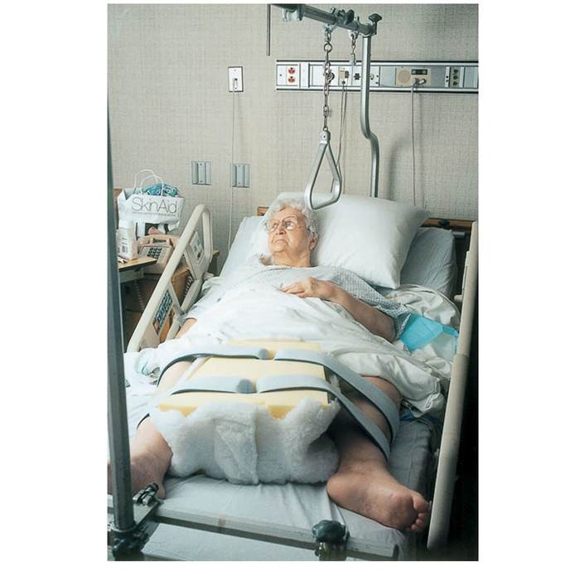
Abductor Pillow

Slide 75
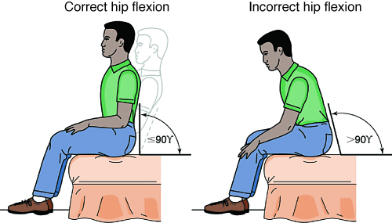
Hip Flexion After Total Hip Replacement

Slide 76
Total Hip Replacement (continued_3)
Postoperative care to prevent complications
Infection
Prophylactic antibiotic
Coughing and deep breathing
Incisional care
Bleeding
Monitor incision
Drainage from drain if present
Neurovascular compromise
Neurovascular checks

Slide 77
Total Hip Replacement (continued_4)
Postoperative care to prevent complications (continued)
Ambulation
Physical therapy
Walker/crutches

Slide 78
Total Hip Replacement (continued_5)
Thromboembolic prevention
Compression devices
Leg exercises
Anticoagulants
Example: Enoxaparin (Lovenox)

Slide 79
Total Hip Replacement (continued_6)
Self-care
Assistive dressing devices
Raised toilet seat
Rehabilitation

Slide 80
Total Knee Replacement
Components: Femoral, tibial, patellar button
Dislocation not a concern
Postoperative care similar to total hip replacement

Slide 81
Amputation
Removal of a body part
Surgical amputations
Ischemia from peripheral vascular disease
Bone tumor, frostbite, congenital problems, infections
Traumatic amputations
Accidents

Slide 82
Amputation (continued_1)
Replantation
Wrap severed body part in clean, slightly moist cloth.
Place in sealed plastic bag submerged in ice cold water.
Transport to hospital.

Slide 83
Amputation (continued_2)
Levels of amputation
Below the knee
Above the knee
Below the elbow
Above the elbow

Slide 84
Amputation (continued_3)
Nursing care
Preoperative nursing diagnoses
Deficient Knowledge
Teach preoperative procedures.
Disturbed Body Image
Begin support services.

Slide 85
Amputation (continued_4)
Nursing care (continued)
Postoperative
Hemorrhage prevention
Infection
Pain control: Phantom pain, phantom sensation
Mobility and ambulation
Patient education
Prosthesis
Lifestyle adaptation

Slide 86
Review Question
The nurse evaluates the patient as understanding teaching on the purpose of a test dose of gold therapy if the patient states which of these?
“To avoid waste of expensive gold.”
“To determine the necessary dose.”
“To determine the therapeutic response.”
“To assess for an allergic reaction.”

Slide 87
Review Question Answer
Correct Answer: 4

Slide 88
Review Question (continued_1)
The nurse would educate the nurse’s aide on the use of which of these techniques for safe patient movement? Select all that apply.
Apply non-skid footwear.
Lift up under patient’s arms to reposition.
Use lifting device.
Use lift sheet.
Sit on bedside before standing.
Use walking belt.

Slide 89
Review Question Answer (continued_1)
Correct Answer: 1, 3, 4, 5, 6

Slide 90
Review Question (continued_2)
The nurse is collecting data on a patient who has fallen. Which patient data would alert the nurse to a possible hip fracture? Select all that apply.
Crepitation
Deformity
Groin pain
Increased range of motion
Limb rotation
Lengthening of limb

Slide 91
Review Question Answer (continued_2)
Correct Answer: 1, 2, 3, 5

Slide 92
Review Question (continued_3)
The nurse would evaluate the patient who is age 60 as requiring further teaching if the patient states which of these prevents osteoporosis? Select all that apply.
“I should avoid alcohol.”
“I should avoid smoking.”
“I should consume vitamin D 600 I U daily.”
“I should consume calcium 1,000 milligram daily.”
“I should increase my vitamin A intake.”
“I should limit weight-bearing exercise.”

Slide 93
Review Question Answer (continued_3)
Correct Answer: 4, 5, 6

Slide 94
Review Question (continued_4)
After a knee replacement, dislocation is a possible complication.
True
False

Slide 95
Review Question Answer (continued_4)
Correct Answer: 2
False, dislocation is not a concern.

